Slide 1

Portfolio Diversification
Wharton Business and Financial Modeling Capstone
Rijul Mehra
15-Aug-2022

Slide 2

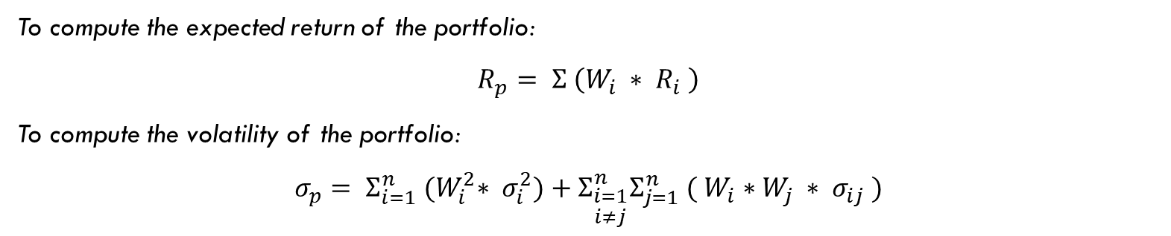
Portfolio DESIGN
When investing, our primary objective is to maximize return while minimizing risk.
Diversification's objective is to decrease losses by creating a portfolio of varied assets.
Objective – We attempt to create an optimal portfolio of diversified assets. This investment offers the highest return relative to risk. To comprehend this, we must examine Markowitz portfolio theory, the efficient frontier, and the capital market line.
To compute the expected return of the portfolio:
$$R_{p}= Σ \left(W_{i} ∗ R_{i} \right)$$
To compute the volatility of the portfolio:
$$σ_{p}= Σ_{i=1}^{n} {(W}_{i}^{2}∗ σ_{i}^{2})+Σ_{\begin{aligned}i=1 \\ i≠j\end{aligned}}^{n}Σ_{j=1}^{n} {( W}_{i} ∗W_{j} ∗ σ_{ij} )$$

Slide 3
Two Mutual FUNDs
VBTLX
Mean | 0.001704167
Standard Error | 0.001170137
Median | 0.0011
Mode | 0.0012
Standard Deviation | 0.008106944
Sample Variance | 6.57225E-05
Kurtosis | 0.271769128
Skewness | 0.019049111
Range | 0.0402
Minimum | -0.017
Maximum | 0.0232
Sum | 0.0818
Count | 48
VFIAX
Mean | 0.012379167
Standard Error | 0.004367581
Median | 0.0165
Mode | #N/A
Standard Deviation | 0.030259487
Sample Variance | 0.000915637
Kurtosis | 0.131266093
Skewness | -0.338996283
Range | 0.1447
Minimum | -0.0604
Maximum | 0.0843
Sum | 0.5942
Count | 48
Our objective is to invest $5 million dollars into two mutual funds :-
VBTLX – Vanguard Total Bond Market Index Fund is an Intermediate Core Bond fund from vanguard fund family with $286.54B net assets under management. Invests majorly in government securities and corporate bonds
VFIAX – Vanguard 500 Index Fund is a large blend fund from vanguard family with $709. 8B net assets under management. Coverage to 500 of the biggest corporation is provided by this fund.

Slide 4
Optimal Portfolio
I encourage placing 67.85% of the portfolio in VBTLX and 32.15% in VFIAX, respectively..
Alternatively put, of the $5 million, I advocate making an investment of about $3.39 in VBTLX Fund and $1.61 million in the VFIAX Fund. In my opinion, this recommended distribution will reduce risk and will produce greater return on the a forementioned portfolio

Slide 5
Efficient Frontier of Two Funds
Capital Market Line
Various portfolio combinations are shown in the graph with the CML touching the optimal portfolio.
Sharpe ratio is the ratio to describe how much excess return you receive for the extra volatility you endure for holding a riskier asset or a portfolio.
The reward to risk ratio is maximum on the portfolio that invests 67.85% in VBLTX and 32.15% in VFIAX.
CML represents portfolio that optimally combine risk and return.
CML represents the portfolio that gives the return of 0.51% while receiving a volatility of 1.07%
Return
0.4746
Risk
Efficient frontier is the set of optimal portfolios that deliver the highest expected return for a given risk level.

Slide 6
Comparing Returns
The graph above illustrates how the value of a $5 million portfolio formed at the end of December 2015 and invested entirely in AAPL,VBTLX,VFIAX or the optimal portfolio consisting of 67.15% in VBLTX and 32.15% in VFIAX would have changed from the end of December 2015 to the end of July 2016.
As can be seen, a portfolio consisting solely of VBTLX or VFIAX generates a higher return than investing the entire amount in AAPL, which not only generates a lower return but is also the riskiest option. Investing in an optimal portfolio with diversification yields a greater return while minimizing losses.

Slide 7
Importance of portfolio Diversification
AAPL
Mean | 0.004276518
Standard Error | 0.036637873
Median | -0.001287567
Mode | #N/A
Standard Deviation | 0.0969347
Sample Variance | 0.009396336
Kurtosis | -1.274657384
Skewness | -0.206986143
Range | 0.267131755
Minimum | -0.13992111
Maximum | 0.127210645
Sum | 0.029935623
Count | 7
Optimal Portfolio
Mean | 0.009451809
Standard Error | 0.004190431
Median | 0.005891279
Mode | #N/A
Standard Deviation | 0.011086838
Sample Variance | 0.000122918
Kurtosis | 0.450920029
Skewness | 0.485110005
Range | 0.034456642
Minimum | -0.00621079
Maximum | 0.028245852
Sum | 0.066162663
Count | 7
As you can see the stock is giving a return of 0.45% while the optimal portfolio of 0.95%
AAPL is 8.58% more volatile than the optimal portfolio
Portfolio Sharpe Ratio = 0.852526
AAPL Sharpe Ratio = 0.044118
Therefore, the Sharpe ratio of optimal portfolio is greater than the stock.
This proves that portfolio gives better overall return with significantly lower volatility in the monthly return due to diversification.

Slide 8
Conclusion
As we have seen, both theoretically and with the aid of an illustration, the advantages of portfolios vastly exceed their disadvantages over the long term, and portfolios generate much higher, more consistent returns in the typical situation.
It can be observed that investing in AAPL will generate lesser returns and is far more risker than compared to the optimal portfolio.
Diverse investment channels help to level out portfolio performance over the long term. It is always preferable to invest in portfolios, i.e., to diversify, if you have a thorough understanding of the suitable diversification approaches and take market conditions into account.

Slide 9

Thank you

